Slide 1
BATTERY TEMPERATURE MONITORING

Slide 2
Battery temp monitoring
Introduction
Temperature is one of the most critical determinants of battery life. When temperatures go abnormal (higher than stated in the specs), battery life is cut short hence expected service life is not attained.
For this reason, we must closely monitor battery temperatures to avoid the losses which could occur.
The only way we are able to remotely monitor battery temperature is by use of the RMS (Galooli) system. This system reads temperature parameters directly from the controller (orion,psc3, SMU02B,SP2 master etc.) hence for correct values to be registered, all the hard and softwares in link with the controller must be well aligned.
This document is meant guide the team on how to rectify the common causes of errors in temperature reading on the RMS systems. We shall then be handling each BBS and its common faults.

Slide 3
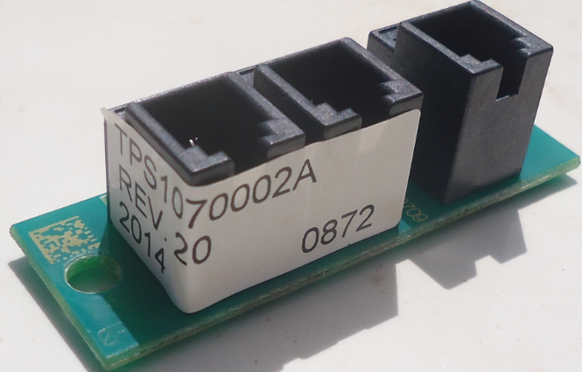
General causes of invalid temperature readings on the RMS system
There are number of conditions causing this, however, below are the most common ones,
-Cut/damaged sensors
This is mostly done at the time of site commissioning or when swapping/ installing batteries. Care must be taken when doing these activities to avoid damage. To put the system back to life, the damaged sensor should be replaced.
-Wrong positioning of the sensors
Sensors should be installed between batteries so that they can pick battery temperatures. Wrong positioning will result into wrong values.
-Faulty temp sensor splitter cards.
Only deltas with Orion controllers have these cards.

Slide 4
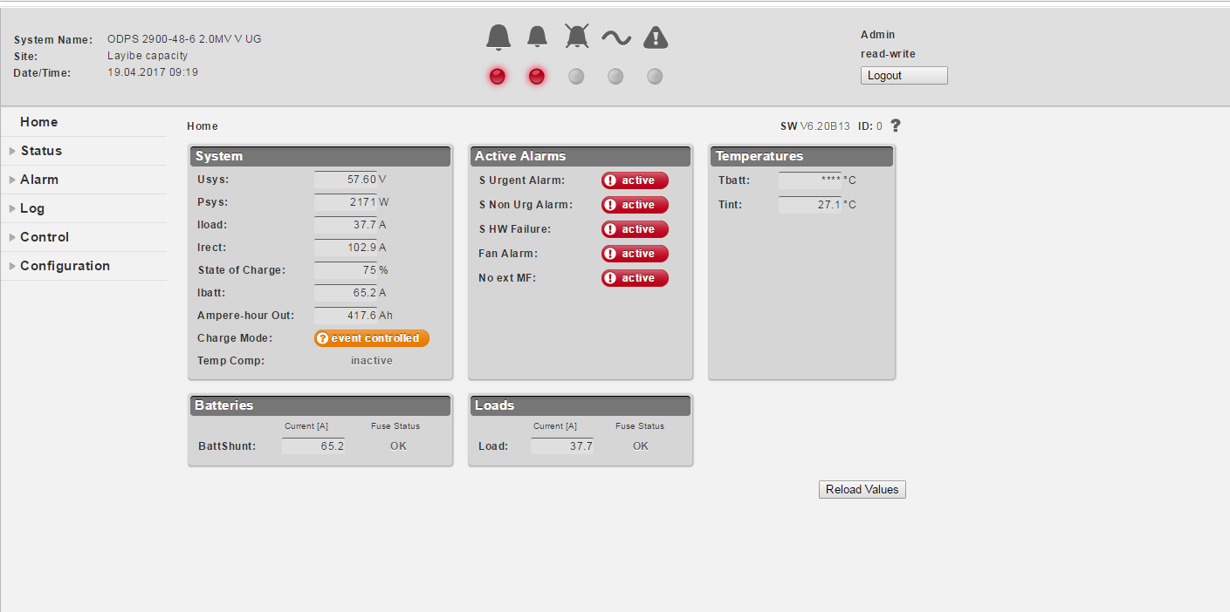
.
The splitter board enables the controller to pick two temperature values (battery and cabinet internal temperatures). It is usually affected by surge/ lightening, its failure means no temperature value is read by the controller. In this case it has to be replaced.
-wrong configurations
When temperature sensing is not enabled in the set-up loaded on to the controller , the reading will not show up on the system. Care must be taken to have the sensing enabled.
-6.5 orion SW miss-match with galooli SW
With this orion sw, a reading like 32.1 is interpreted as 321. this error is however being addressed by galooli team and soon will be eliminated.
-A few controllers failing to read temps
This is common to sites which were once struck by lightening, temp sensing is also affected after the action. This controller has to be replaced. Below is what is seen when one logs in;

Slide 5
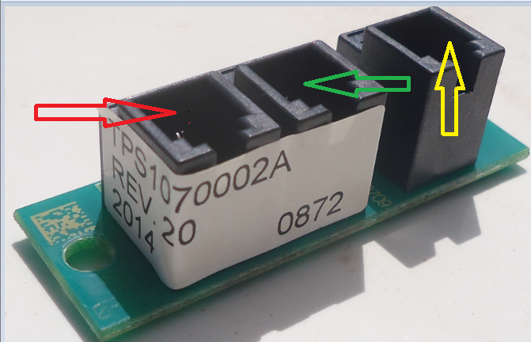
Layouts and connections
ORION
This seats on to a backplane, all the communication from the different units of the BBS is linked to it via the back-plane. The temp port on the back-plane is linked by a cut 6 cable to another board (temp sensor splitter board). This board pick two temp values (battery and internal temps) and this makes the Orion unique from other controllers.
Prrr
Port functions;
-Red arrow- picks internal temperatures
-Green arrow- picks battery temperatures
-Yellow arrow- connects to the backplane

Slide 6
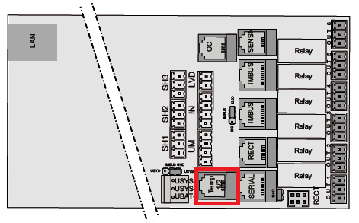
PSC3
With this type of controller, there is only one sensor (for battery temp). This is directly connected to the back of the controller. The temp probe is then laid between the batteries.
D
Eltek SP2
This has a battery monitor which is connected to the I/O monitor. The battery monitor is then installed in the battery cabinet just next to the middle/second string.

Slide 7
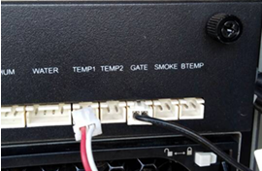
SMU 02B
This controller monitors parameters of the Huawei TP48200A. The TP has ability to monitor temperature form 3 points
However, we are most interested in BTEMP (battery temperature). The sensor socket must then be moved to the BTEMP port and then the battery temp sensor moved to the batteries.
After these changes, we must change a few setting on the controller to enable battery temp measurement. This process can be done manually on the controller .
Note;
Username; admin
Password; 000001 or Changeme
Below are the steps;

Slide 8
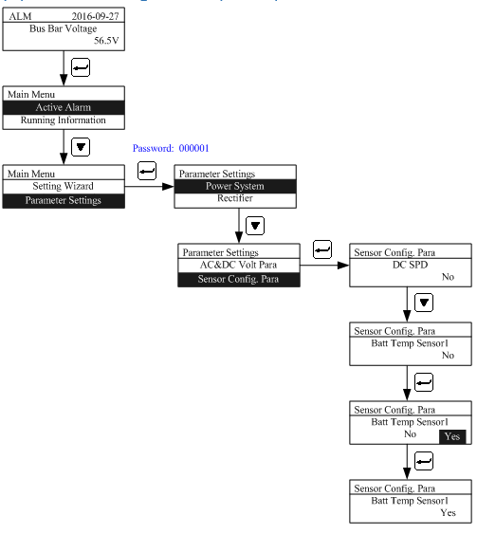
Settings;

Slide 9
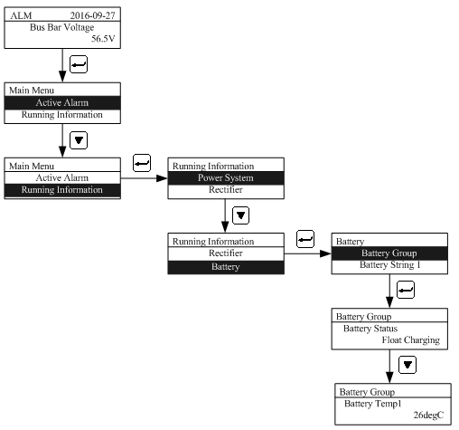
Checking temp readings;
After the configurations are done, do check to confirm that temp readings are being picked.
Below are the steps;

